Slide 1
FLIGHT DATA ANALYSIS
Acorn Airlines VS Berry Airlines
Evangeline Quek Min En A0257905W
Isaac Ng Sheng A0258037B
Lim Jing Yun A0256923X
Tan Si Xuan A0257152H
Shi Wenting A0258166W
Wu Tong A0258943N
Notes:
Mayb add matri no.

Slide 2
Outline
Areas for
improvement
Are we punctual?
04
Moving
Forward
03
Overview
05
02
01
Are we efficient?
Notes:
Diverted under arrival delays
Outline:
Overview

Slide 3
Overview
1
Notes:
Present the overview

Slide 4
Aim:
How can we improve
our airline (AA)
against Berry Airlines (BA)?

Slide 5
What is Performance?
Optimum aircraft utilisation
On time performance
Notes:
Define performance into two categories
One analysing if the airline optimises its aircraft utilisation
Second analysing the on time performance

Slide 6

Proportion of Airlines in Flight Data
Out of the total flights
by both airlines,
Ours
Berry
47.5%
52.5%
Proportions are somewhat balanced
Can use this data as basis for future comparisons
Notes:
Calculated both AA and BA
Balanced, sample size is similar so the later comparisons are valid

Slide 7
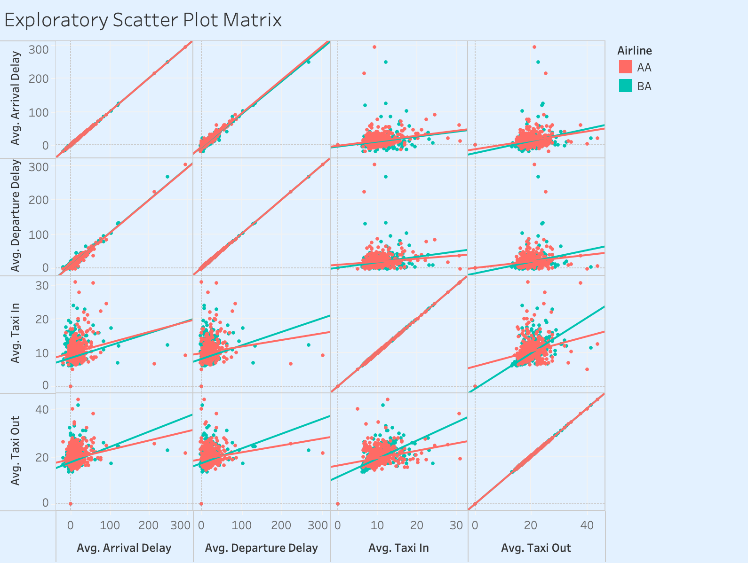

Slide 8
Percentages of Cancellations
Cancellations
Suggests performance issues and
The airline’s ability to handle unpredictable situations
E.g. poor operational planning, overbooking, inadequate maintenance practices
Affects overall reputation & customer satisfaction
Notes:
Cancellations can be caused by many factors
such as weather that is not within our control,
but a high flight cancellation rate
also suggests performance issues and the
airline’s ability to handle unpredictable situations.

Slide 9
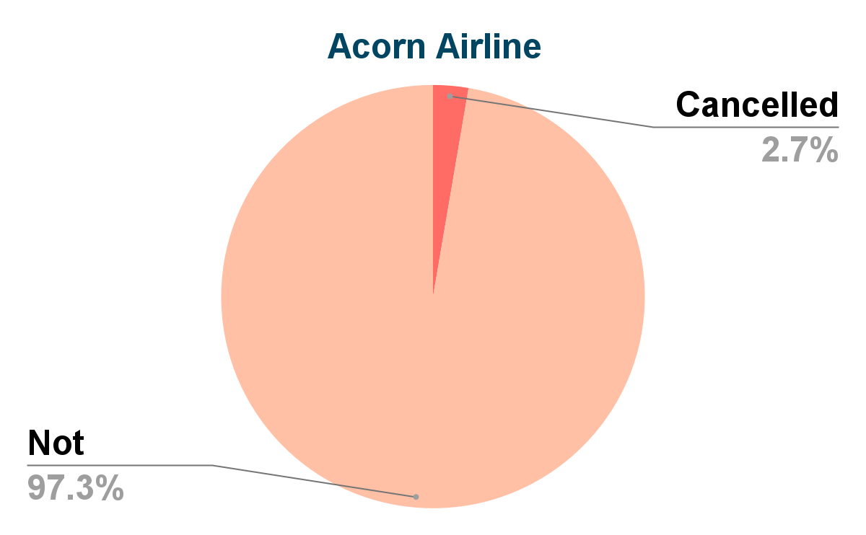
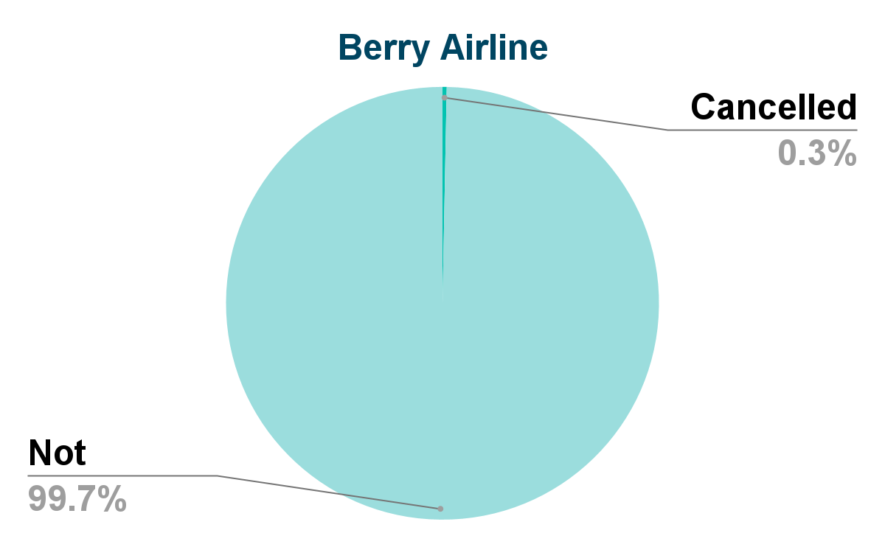
Percentages of Cancellations
Notes:
As we can observe, the difference in % of cancellations seems fairly small in the pie charts, but when we look at the bar graph (next slide)

Slide 10
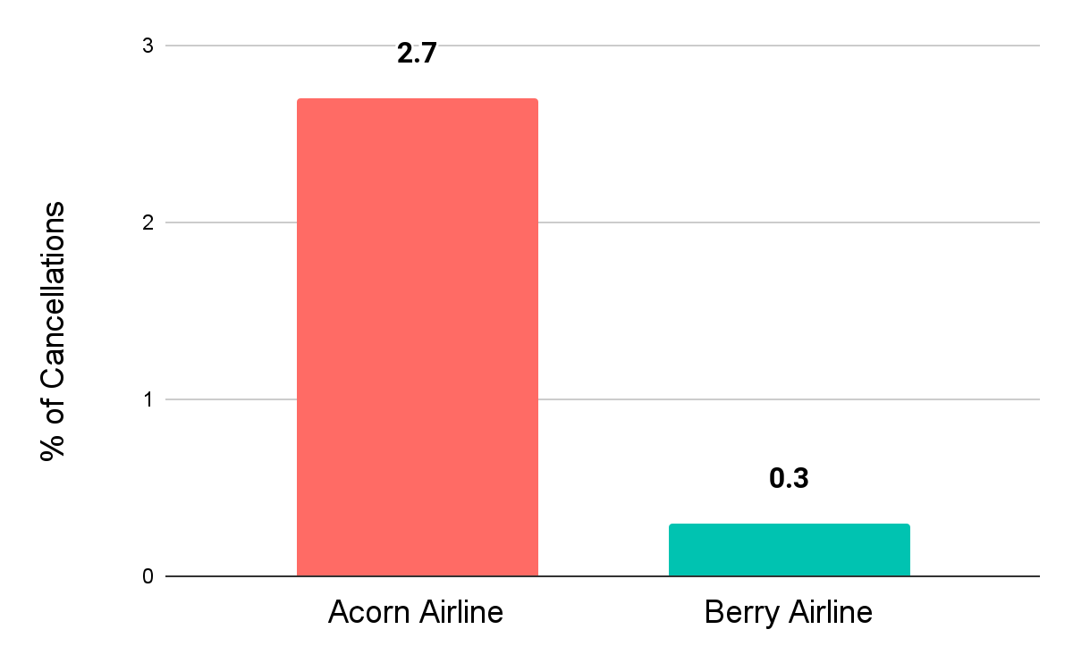
Percentages of Cancellations
% of cancellations
for our airlines is
9 times
that of BA
Notes:
(continuation from prev slide) We can see that there’s actually quite a drastic difference in the percentage of cancellations for each airline. Notably, the % of cancellations for AA is 9 times that of BA
Performance (to be added)
Reuse the slide and say 9 times is significant
Transition to breakdown of cancellation

Slide 11
Key Takeaway
On time performance of AA & BA flights
Gap analysis
We have higher percentage of cancelled flights, suggesting performance issues
04
Proposed Solutions
03
Overview
05
02
01
Aircraft utilisation of AA & BA

Slide 12
Outline
Areas for
improvement
Are we punctual?
04
Moving
Forward
03
Overview
05
02
01
Are we efficient?
Notes:
Diverted under arrival delays
Outline:
Overview

Slide 13
Are we efficient?
2

Slide 14
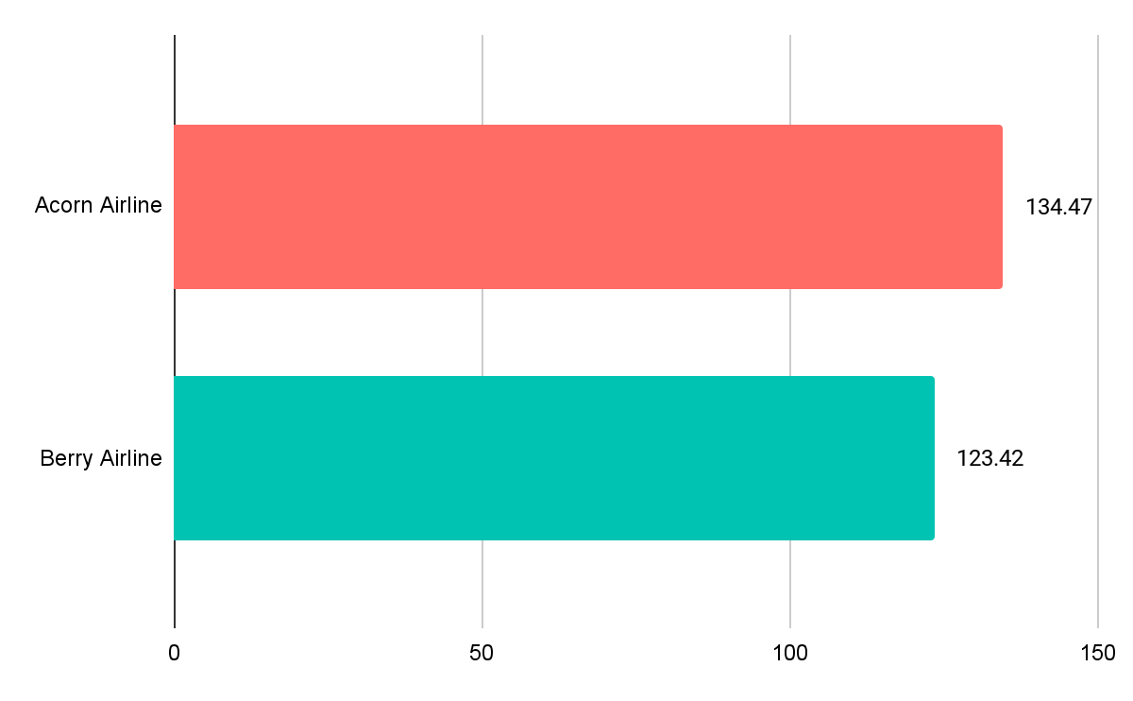
Average Air Time of Planes
On average, our airline has a 11.05 minutes higher air time than Berry Airlines per plane
Notes:
Avg air time:
Judging based on average air time
it seems that acorn airline has a higher utilisation percentage
because during the same period of time, every plane under aa fly for a longer duration of time

Slide 15
What is Taxi In/Out?
TAXI-OUT
time taken for an aircraft to taxi from the gate to the landing for take-off
TAXI-IN
time taken for an aircraft to taxi from the runway to the gate after landing
Notes:
Taxi in/out is used as indicator of operational efficiency (also part of the turnaround time)
By analysing the mins we can identify potential areas for improvements in operations
Optimising gate assignments
Improving ground communication
Implementing more efficient taxing procedure

Slide 16
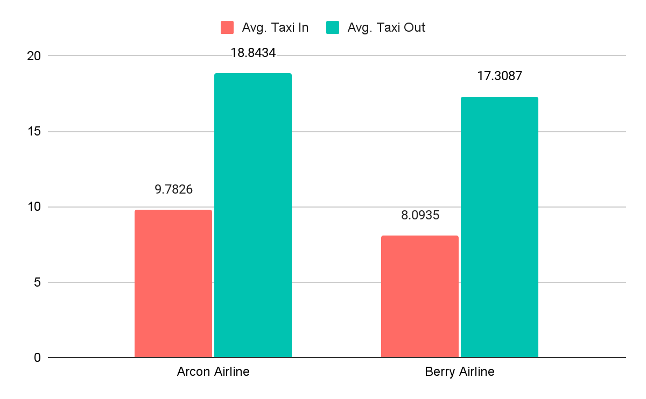
Average Taxi In/Out Time of Planes
Taxi In/Out time
of our airline is
greater
than that of BA
Notes:
Taxi in/out is used as indicator of operational efficiency (also part of the turnaround time)
By analysing the mins we can identify potential areas for improvements in operations
Optimising gate assignments
Improving ground communication
Implementing more efficient taxing procedure
AA taxi-in/out takes more time than BA
This means that AA is taking more time on the runway than BA, being less efficient
AA should look into their scheduling to understand why their aircrafts are taking significantly longer time for taxi in and out

Slide 17
Key Takeaway
Although we have higher average air time per flight,
we also incur higher taxi in and taxi out time.
It could be indicator of longer turnaround time of our airline.
04
03
02
Are we efficient?

Slide 18
Outline
Areas for
improvement
Are we punctual?
04
Moving
Forward
03
Overview
05
02
01
Are we efficient?
Notes:
Diverted under arrival delays
Outline:
Overview

Slide 19
Are we punctual?
3

Slide 20
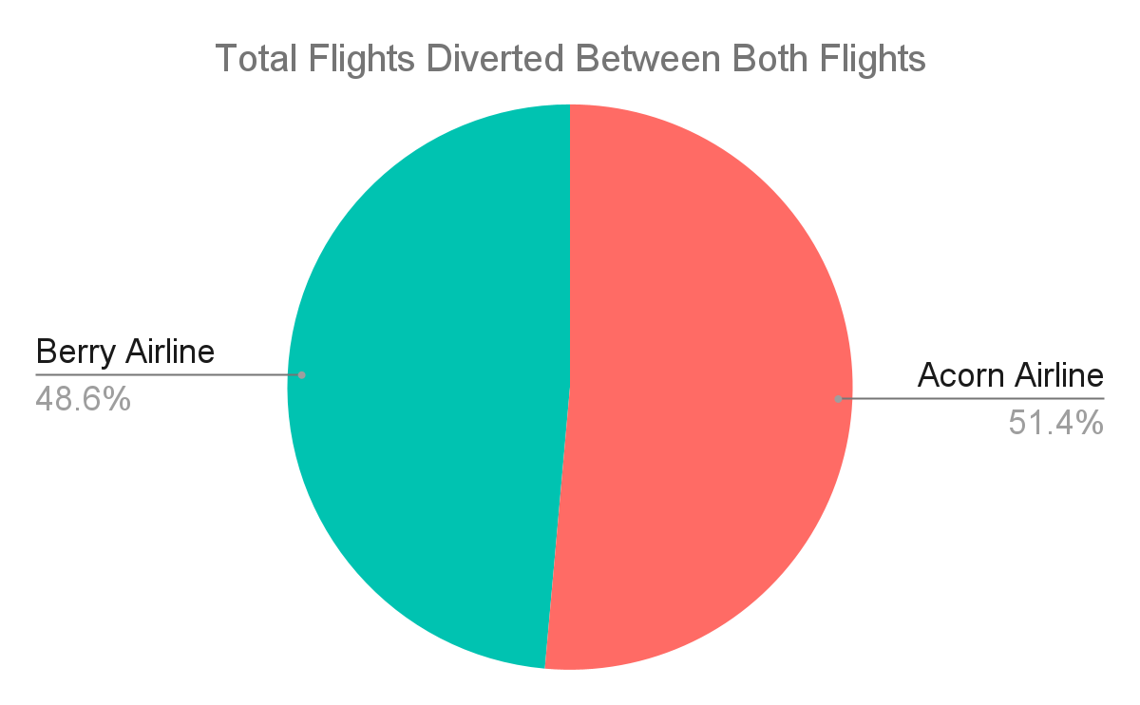
CCCCOM
Comparison of Arrival Diverted
Notes:
Not very significant when looking for insights or to compare between the number of flights delayed
Even if AA delays more flights only by slight proportion
Move on the to factors contributing to Flight Delays

Slide 21
3a Departure Time Delay
3b
Arrival Time Delay

Slide 22
Departure Time
Delay
3a
Notes:
Next, I will be analysing our performance on Departure time

Slide 23
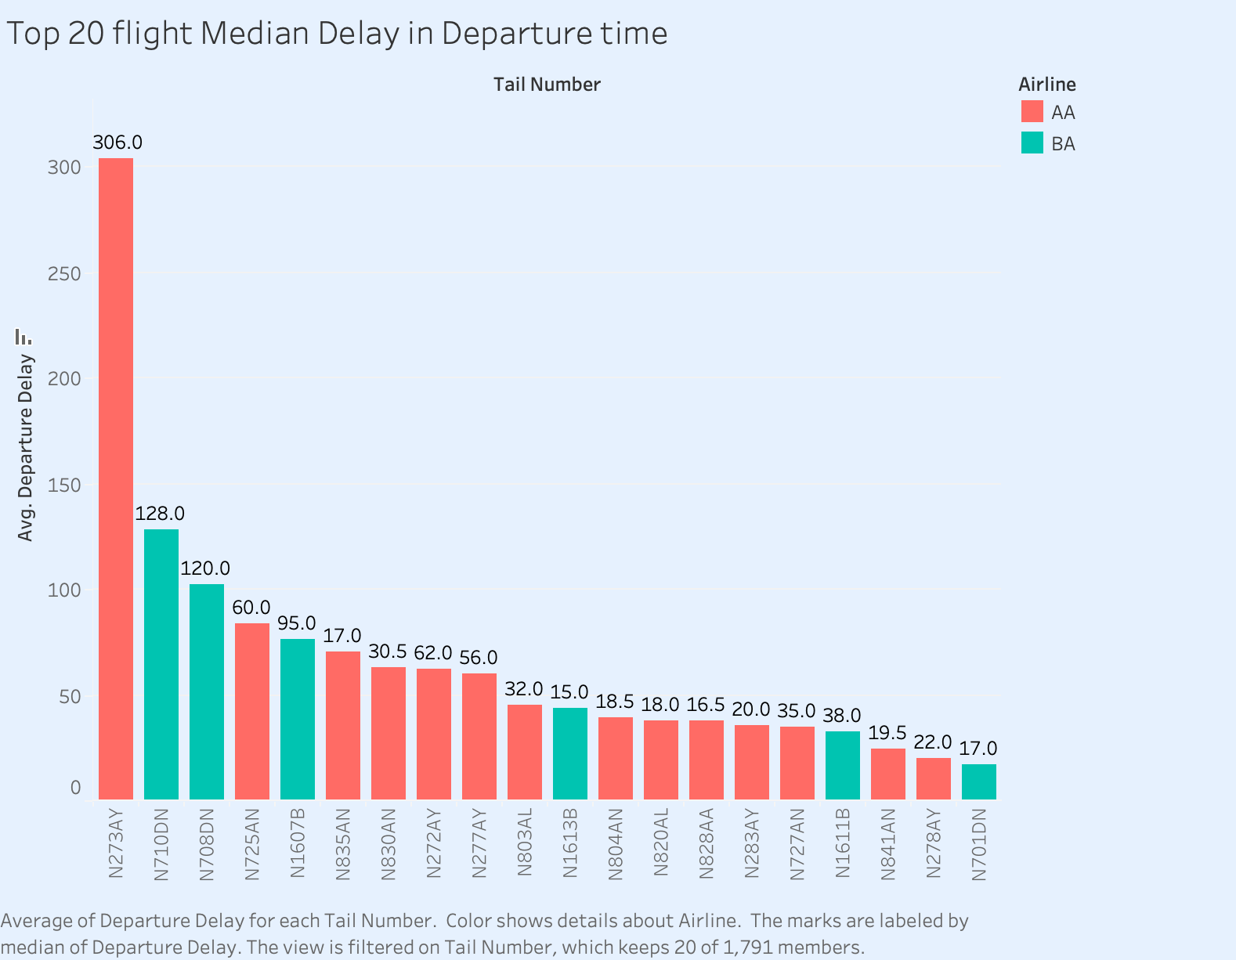
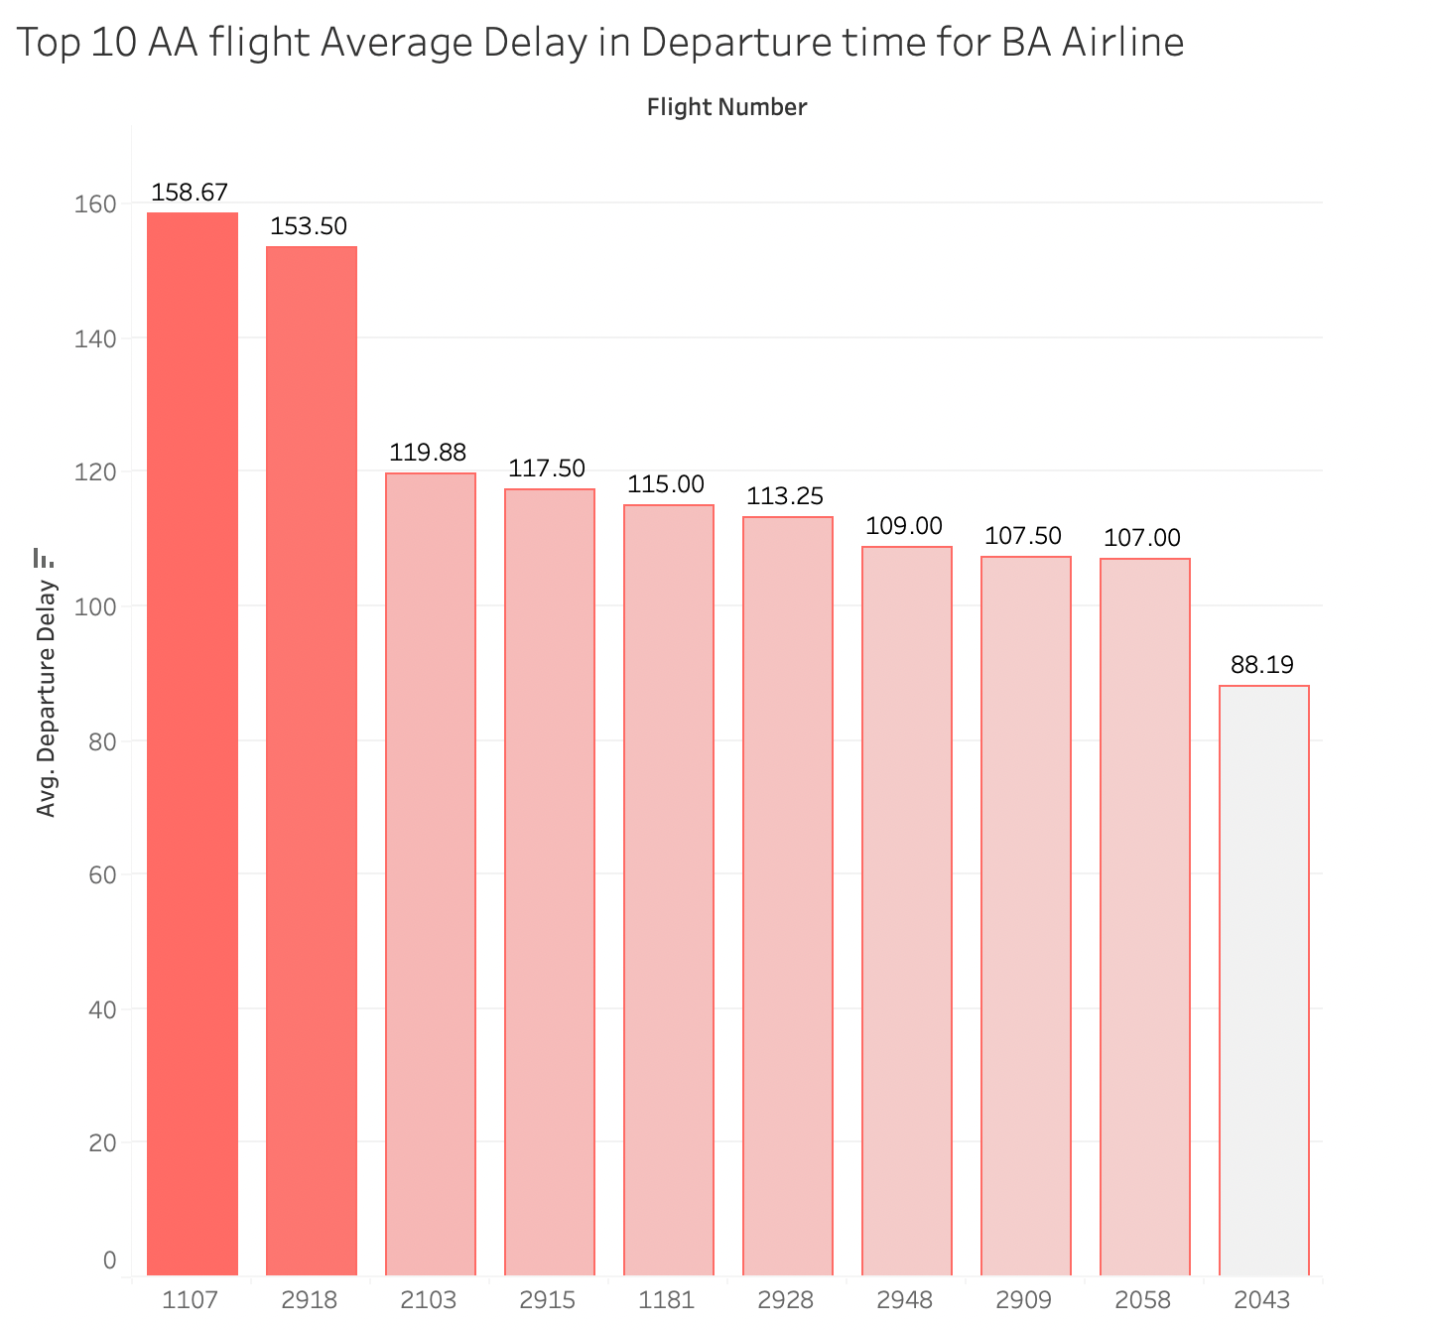
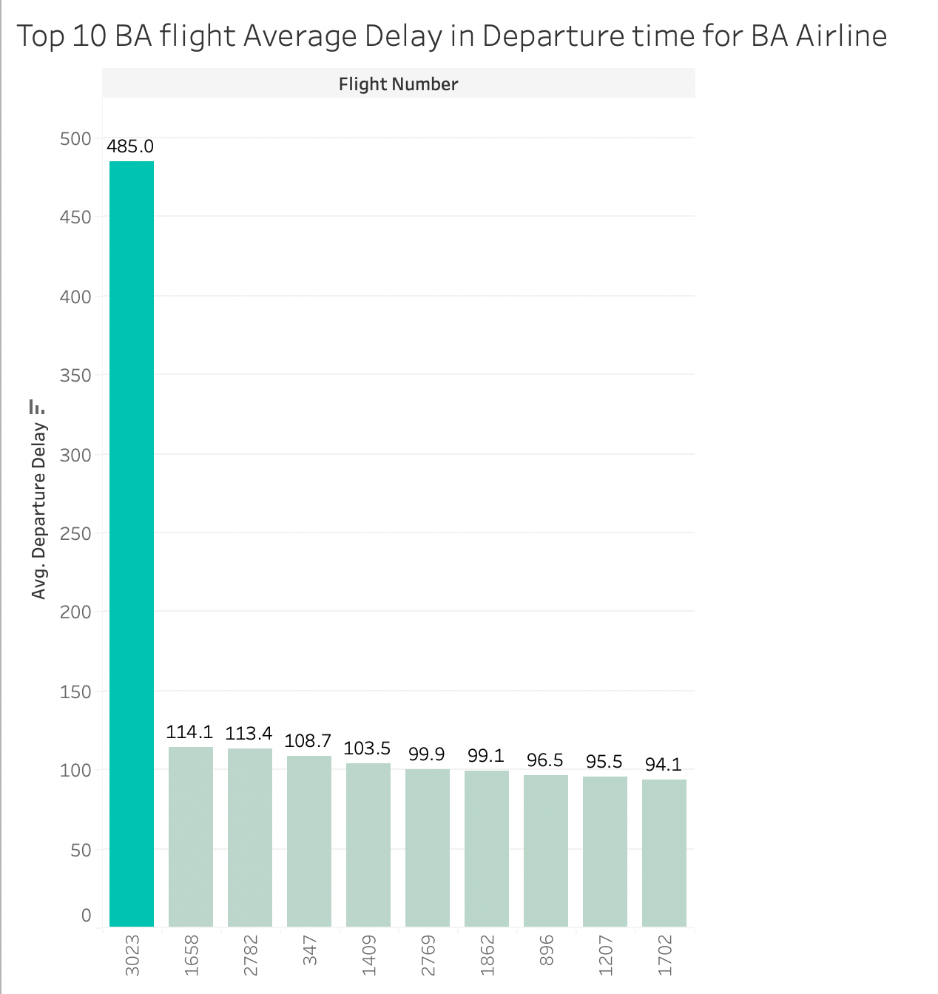
Top 20 Flights by Median Departure Delay
Our airline is experiencing higher departure delay more flights than Berry Airlines.
N273AY
of our airline has a significantly higher median delay than the rest.
Notes:
From this bar chart of top 20 flights by their median departure delay, we can see that our airline is performing worse in departure delay time
The reason why we use median for analysis is that median is barely affected by outliers, giving us more representative results
We have more flights in the top 20 (14 out of 20)
N273AY (under us) has significantly higher median departure delay time, topping the chart
Overall, our airlines are experiencing more delay than BA

Slide 24
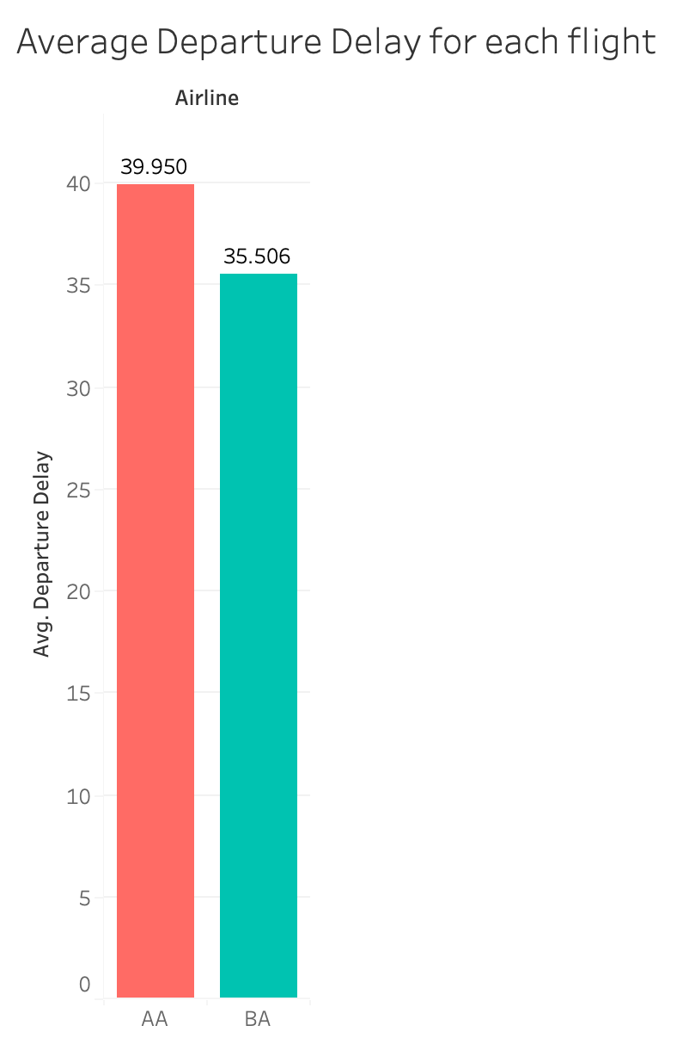
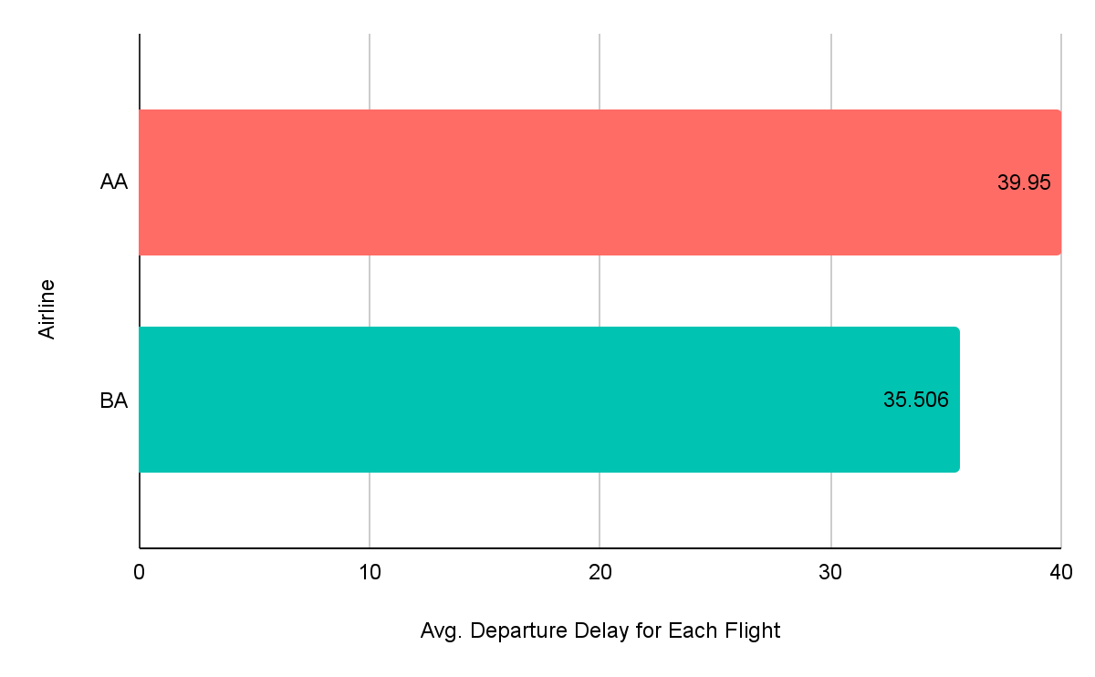
Average Departure Delay
On average, the departure delay for our airline is
12.5% greater
than Berry Airlines
Notes:
However, after taking into sample size into consideration, we find that the size is large enough for the effect of any outliers being minimal.
The average departure delay for AA Airline is higher than that of BA airline by 12.5%, which is a relatively small difference, but still not too small that it is totally insignificant.

Slide 25
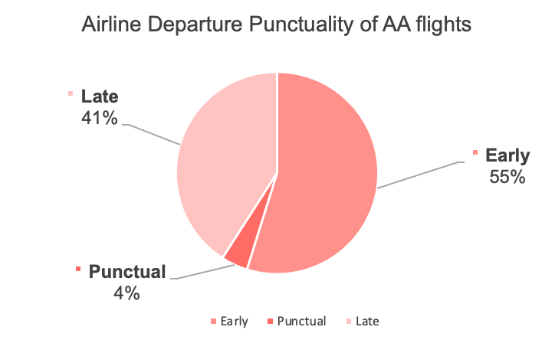
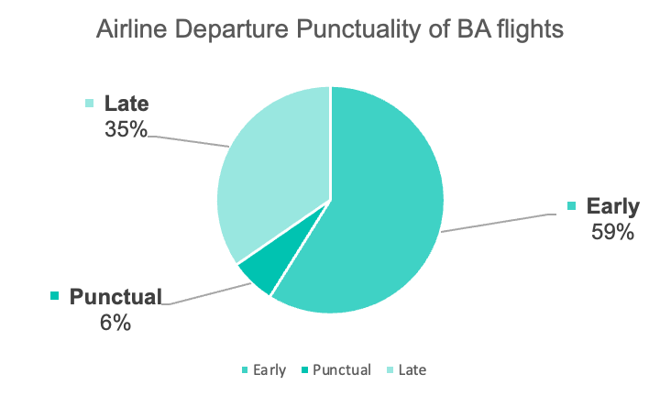
Departure Punctuality
Our airline has a 6% higher percentage of late flights,
2% lower percentage of punctual flights and 4% lower percentage of early flights
Notes:
After looking at the overall departure delay data, now let’s look at a more detailed breakdown of it.
For us, late flights seems to be a problem for since it composes 41% of the total flights which is almost half the proportion of the data.
Moreover, compared to BA, we are behind because we have a [read the slide]
In this case, we are not performing better than BA. We are less punctual, more late departure and less early departure.

Slide 26
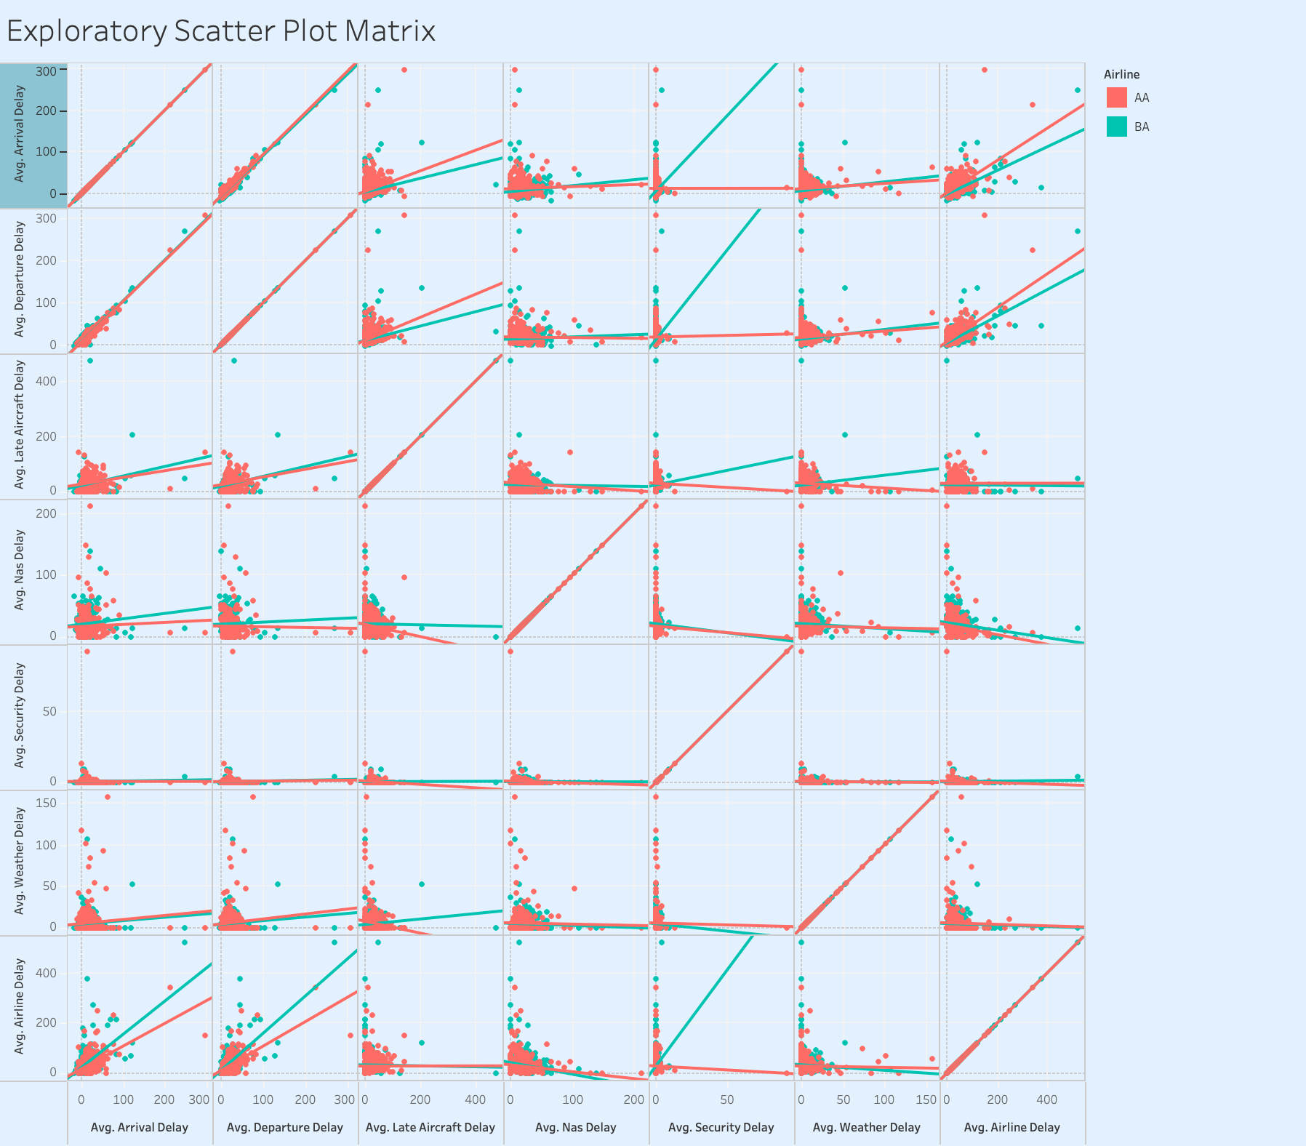
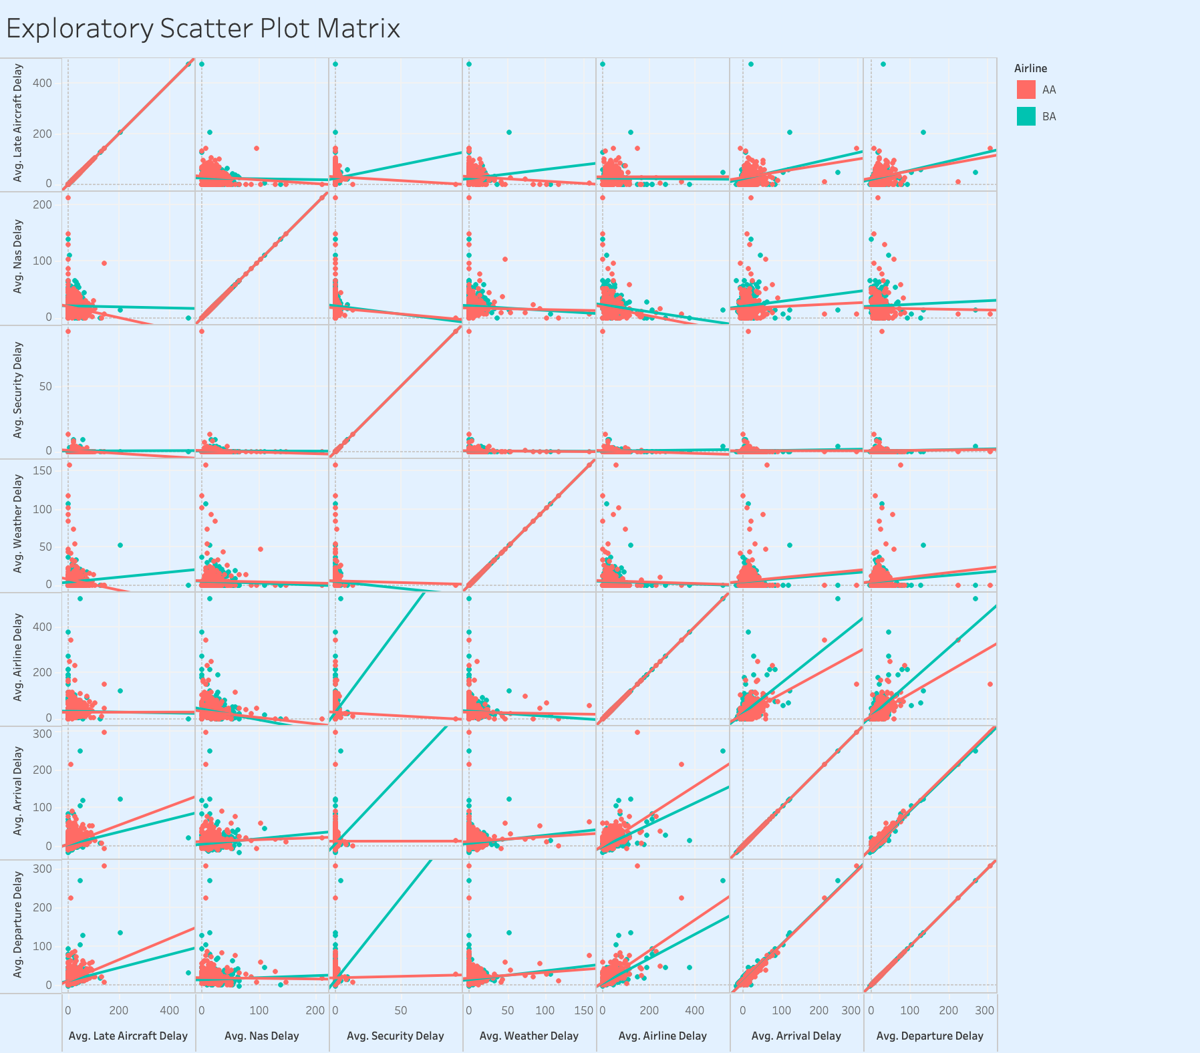
Factors Contributing to Delay
Notes:
What could be the contributing factors towards these results?
We make this exploratory scatter plot matrix with all the potential factors. From the chart, we see that average departure delay seems to be highly positively correlated with average airline delay and late aircraft delay.

Slide 27
Arrival Time
Delay
3b

Slide 28
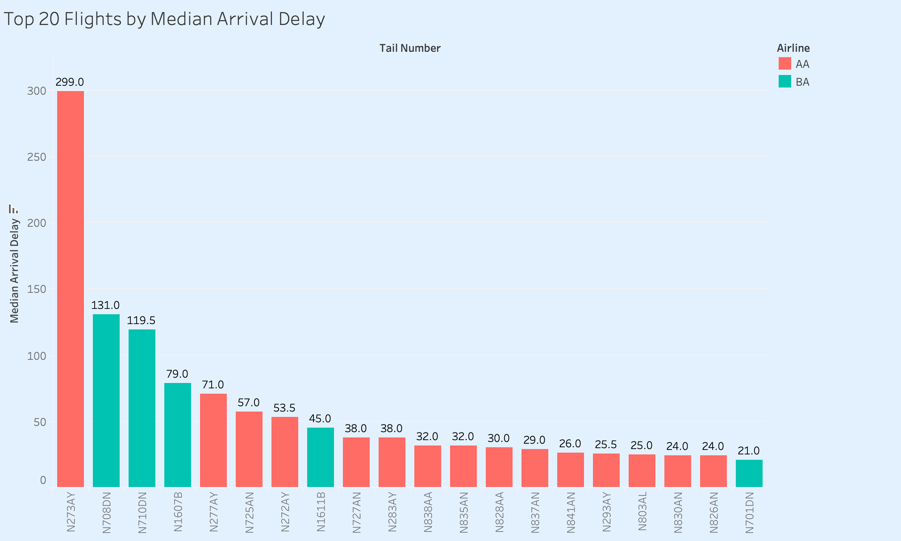
Top 20 Flights by Median Arrival Delay
Our airline is experiencing higher arrival delay than Berry Airlines.
N273AY
of our airline has a significantly higher median delay than the rest.
*Note that N273AY also had the greatest median departure delay.
Notes:
We are performing worse in arrival delay time
We have more flights in the top 20 (15 out of 20)
N273AY (under us) has significantly higher median arrival delay time

Slide 29
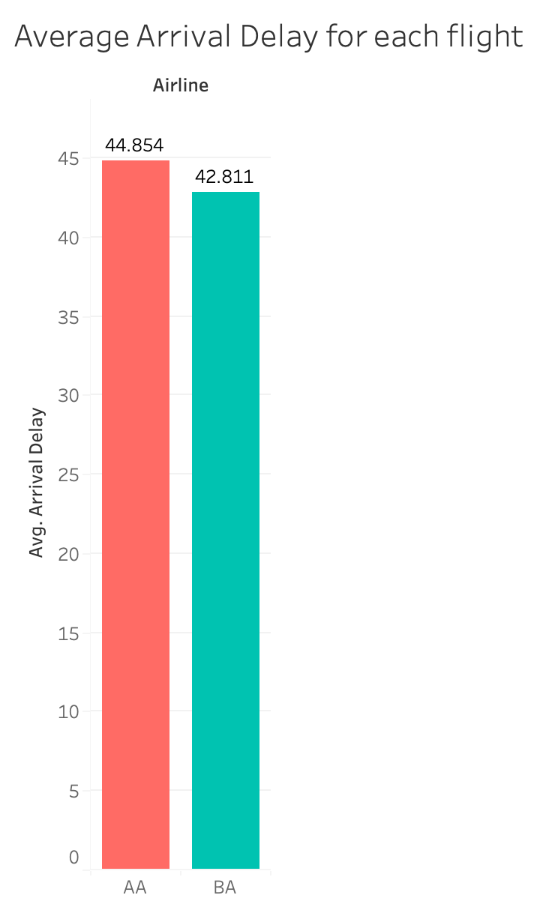
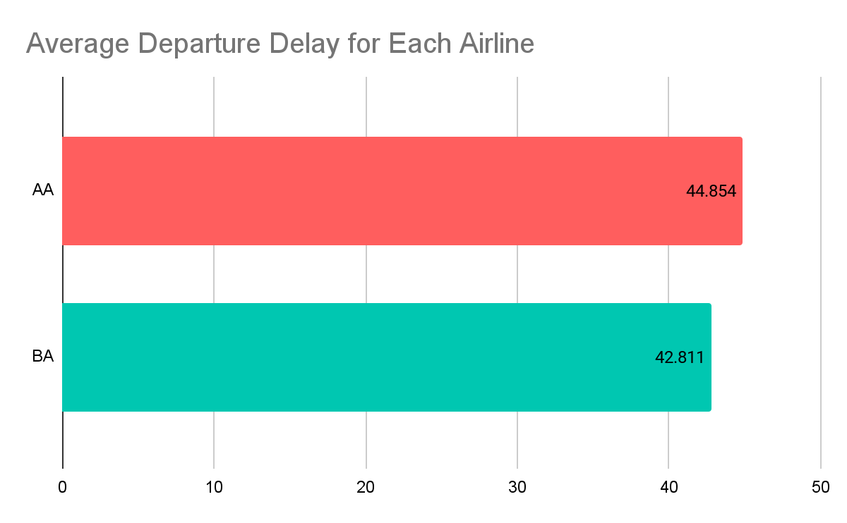
Airline Average Arrival Delay
On average, the arrival delay for our airline is
4.8% greater
than Berry Airlines
Notes:
The average arrival delay for AA Airline is higher than that of BA airline by 2.043 min which is a small difference.

Slide 30
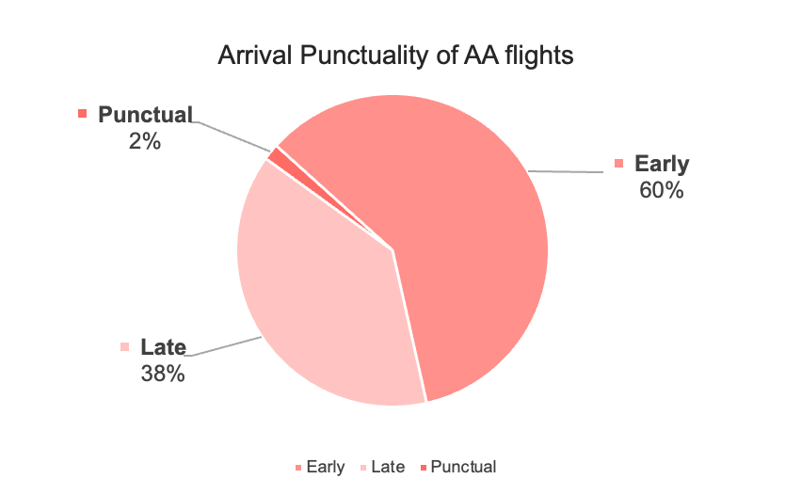
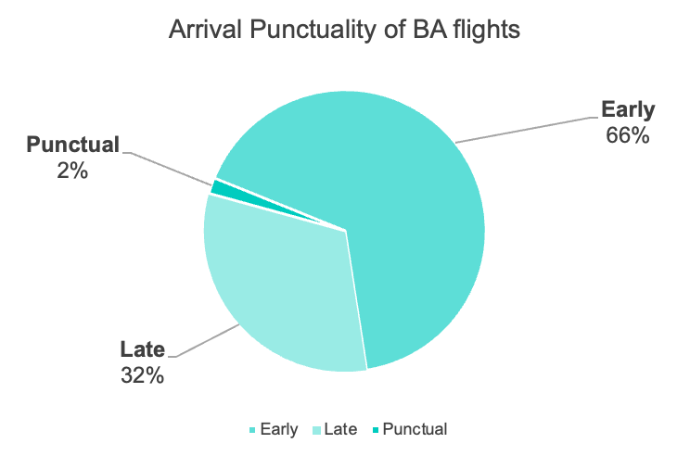
Arrival Punctuality
Our airline has a 6% higher percentage of late flights,
and 6% lower percentage of early flights
Notes:
The proportion of flights that are punctual (arrival on time) is 2% for both airlines. -> equal performance on punctuality for arrival time.
The proportion of flights that arrive later than the scheduled time is 38% for AA, higher by 6% than BA.
The proportion of flights that arrive earlier than the scheduled time is 66% for BA, higher by 6% than AA.

Slide 31
Factors Contributing to Arrival Delay
In the airline’s control:
Not in the airline’s control:
Airline Delay
Late Aircraft Delay
Weather
NAS delay
Security
Notes:
(sorry ugly)
Mention about the factors of contributing to arrival delay
Factors can be controlled
Airline Delay
Late Aircraft Delay
Factors cannot be controlled
Weather
NAS delay
Security

Slide 32
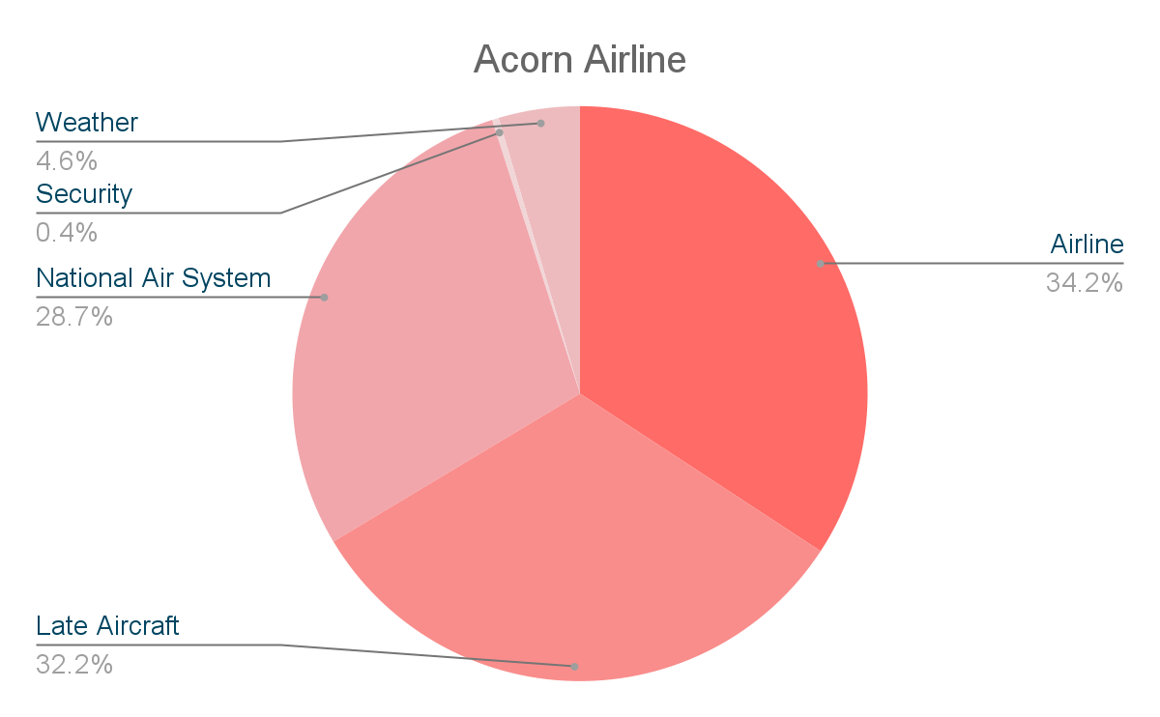
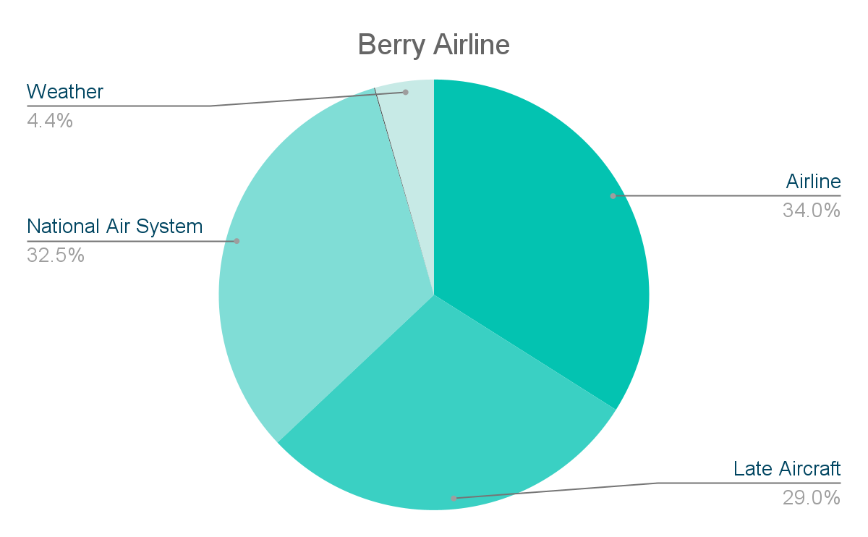
Factors Contributing to Arrival Delay
Security
0.1%
Composition of factors contributing to Arrival Delay is similar for both our airline and Berry Airline.
Most significant factor for both is the Airline Delay.
Notes:
Overall, each reason for delay is experienced to a similar extent, with each reason for delay constituting a similar percentage to the total delay.
Proportion of delay due to factors beyond the airline’s control, such as Weather delay, Security delay and National Air System delay, form close to __ for both airline
33.7 - AA, 37- BA

Slide 33
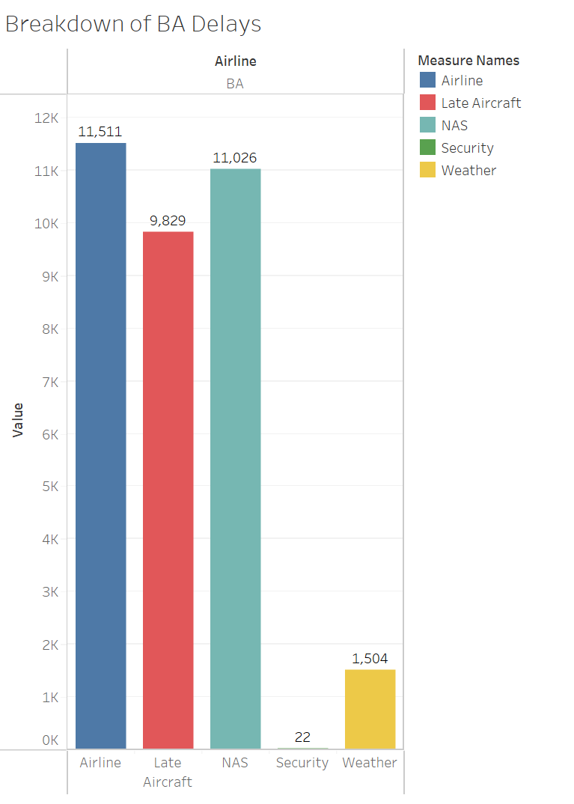
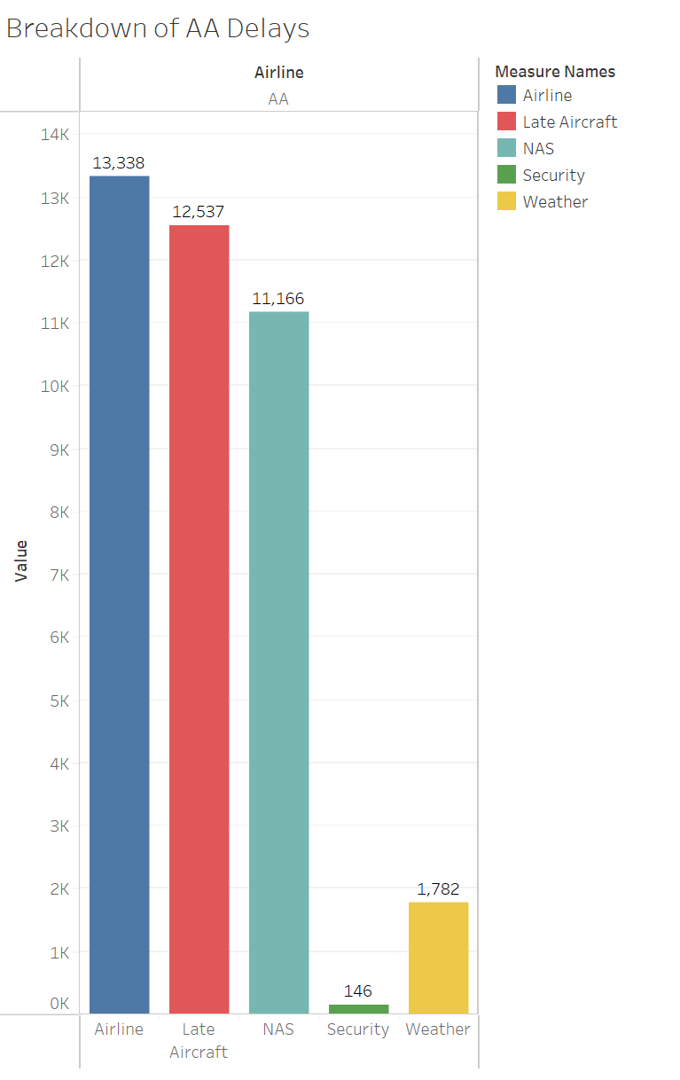
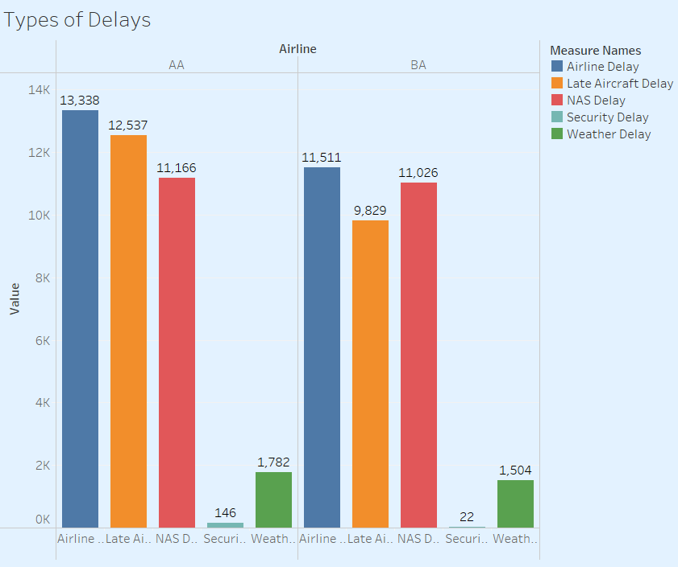
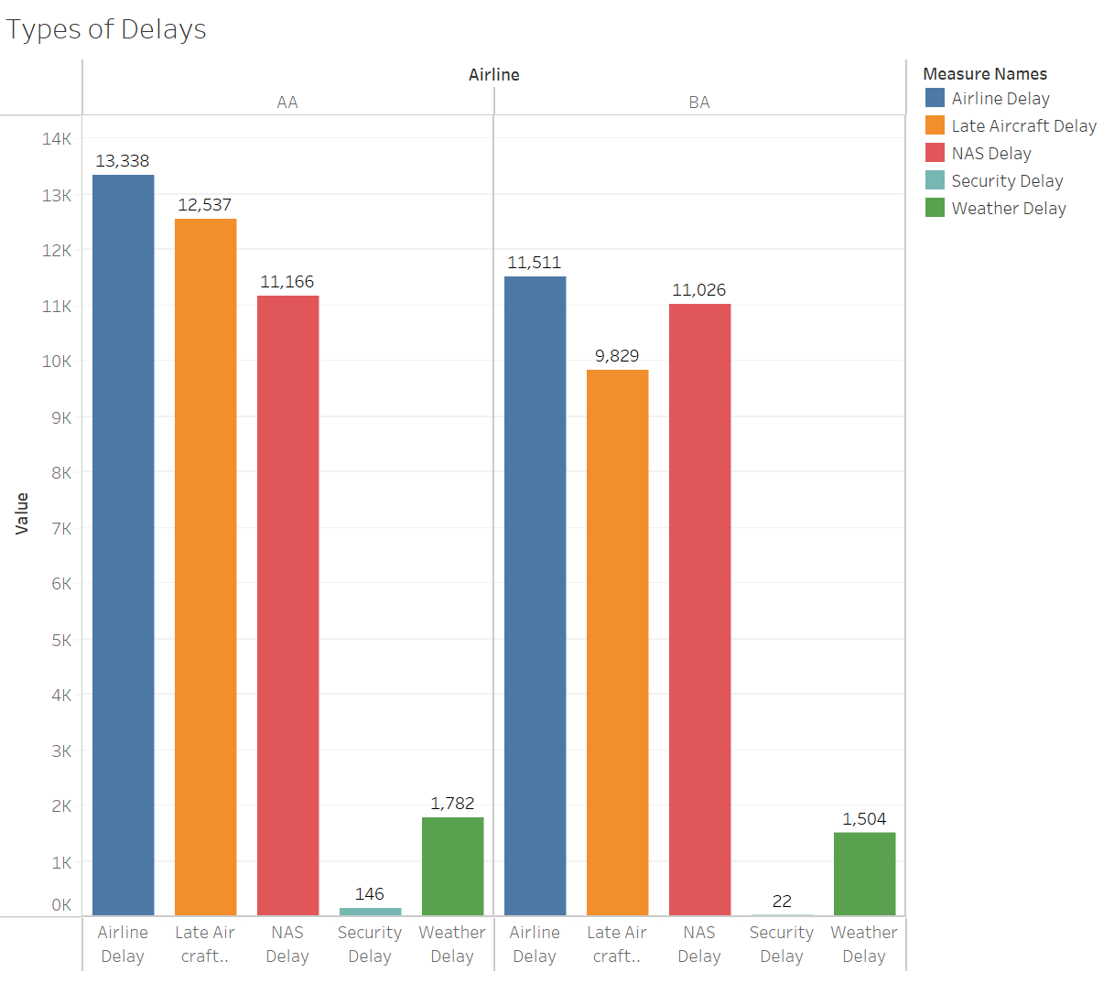
Factors Contributing to Arrival Delay
Our airline has a
greater proportion of arrival delays
with factors that are
within our control
Notes:
In particular we found that both airlines experienced a high frequency of delay due to Airline delay (carrier delay), Late Aircraft Delay and NAS delay .
Aircraft delay is caused by circumstances within the airline’s control such as maintenance, crew problem, aircraft cleaning etc.
Hence, it should be targeted to improve our performance.
AA has significantly higher Late Aircraft Delays than BA
Late Aircraft Delay is caused by the a previous flight of the same aircraft being delayed hence it is generally unavoidable. However, it will naturally improve as we reduce the number of delays in general. target the main factors contributing to delay (possible issue lies with scheduling) Overall: Most of the delays are caused by Airline Delays and NAS Delays for both Acorn and Berry NAS (National Airspace Systems) Delays tend to include factors out of an airline’s control, although they’re able to minimize the impact
https://www.bts.gov/topics/airlines-and-airports/understanding-reporting-causes-flight-delays-and-cancellations

Slide 34
Key Takeaway
Our airline has:
Higher median departure and arrival delay time
Lower percentage of departure punctuality
Significantly higher Late Aircraft Delays
Are we
punctual?
04
03
05
Notes:
Our punctuality issues and delays cause arrival delays that can be improved in the future to enhance its performance compared to BA.

Slide 35
Outline
Areas for
improvement
Are we punctual?
04
Moving
Forward
03
Overview
05
02
01
Are we efficient?
Notes:
Diverted under arrival delays
Outline:
Overview

Slide 36
Areas for improvement
4
Notes:
How us as AA is lacking behind of BA

Slide 37
Key Factors affecting our performance
We can see where our airline is performing worse in:
Cancellations
Arrival and departure
delays
Taxi in & out time
Notes:
Rephrase the sldies

Slide 38
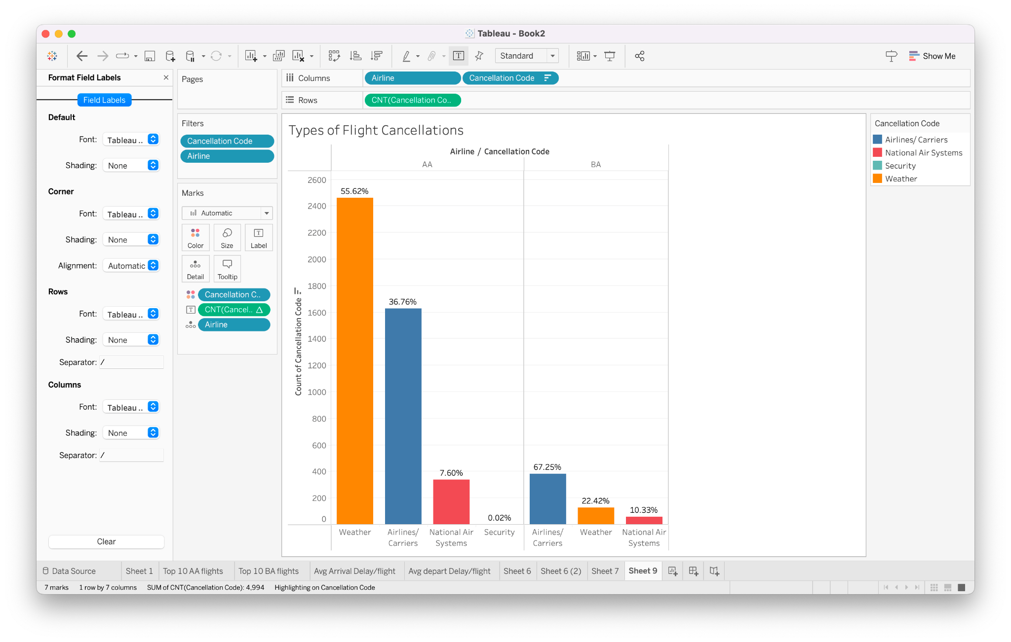
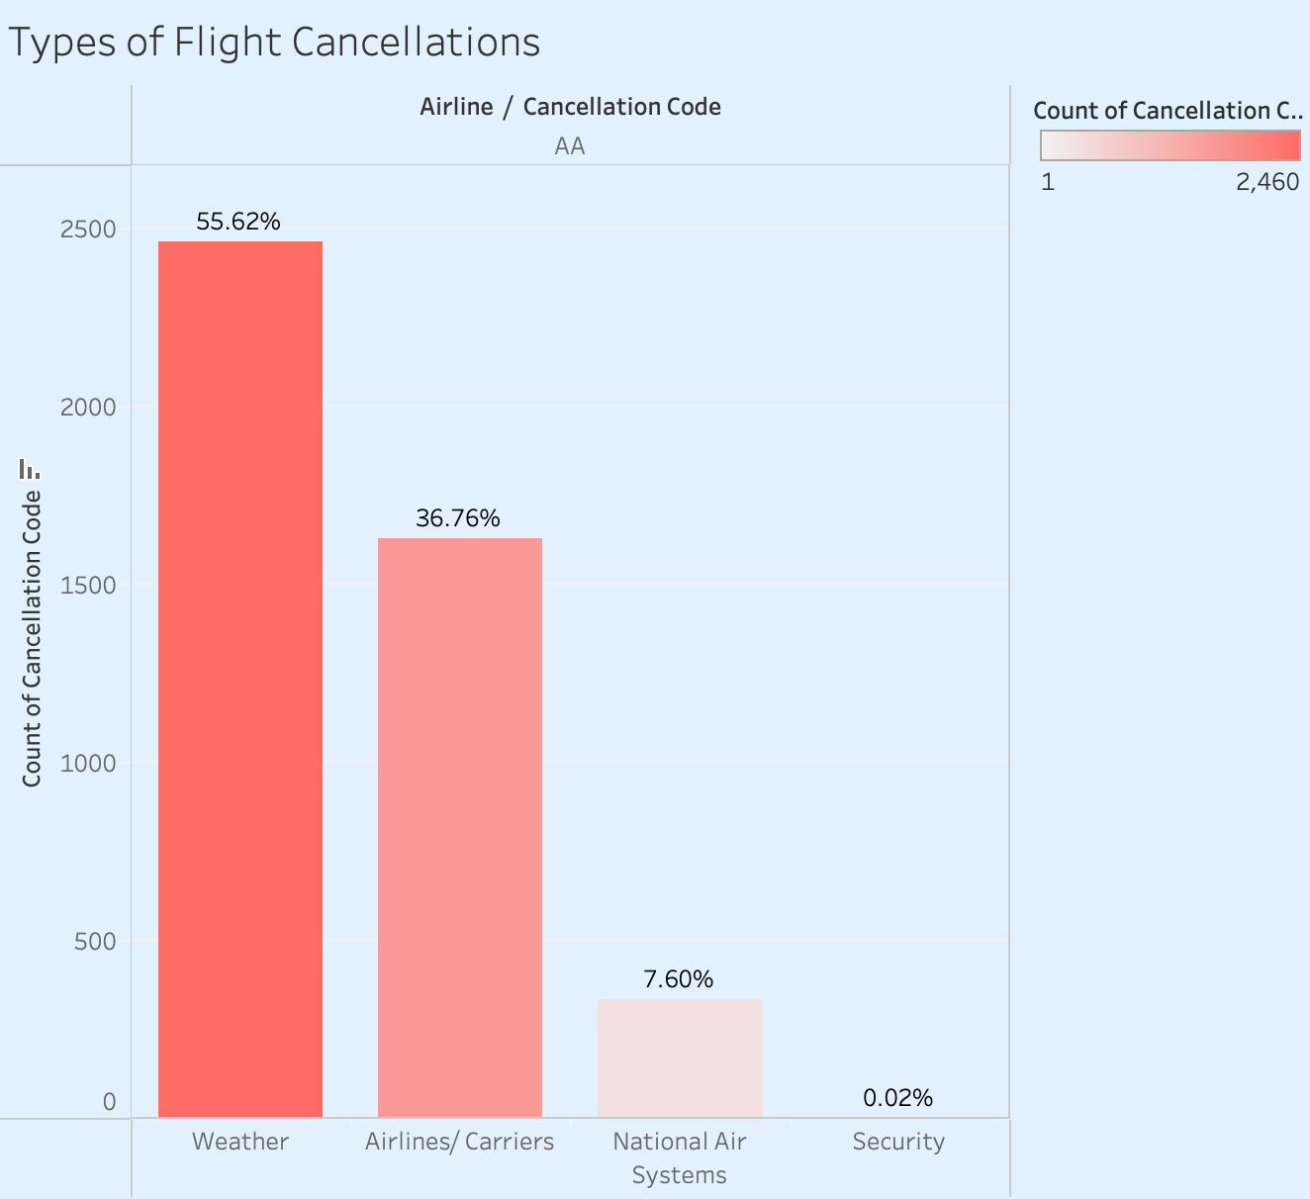
Breakdown of Cancellations
More than half of the cancellations is due to weather,
and more than one third is due to airline/carriers issues.
Notes:
Weather → beyond control, but maybe it suggests that we need to look at weather predictive analytics to improve on scheduling and development of alternative plans(e.g. routes)
Airline /Carriers → needs further investigation to identify the root cause(maintenance, crew availability)

Slide 39
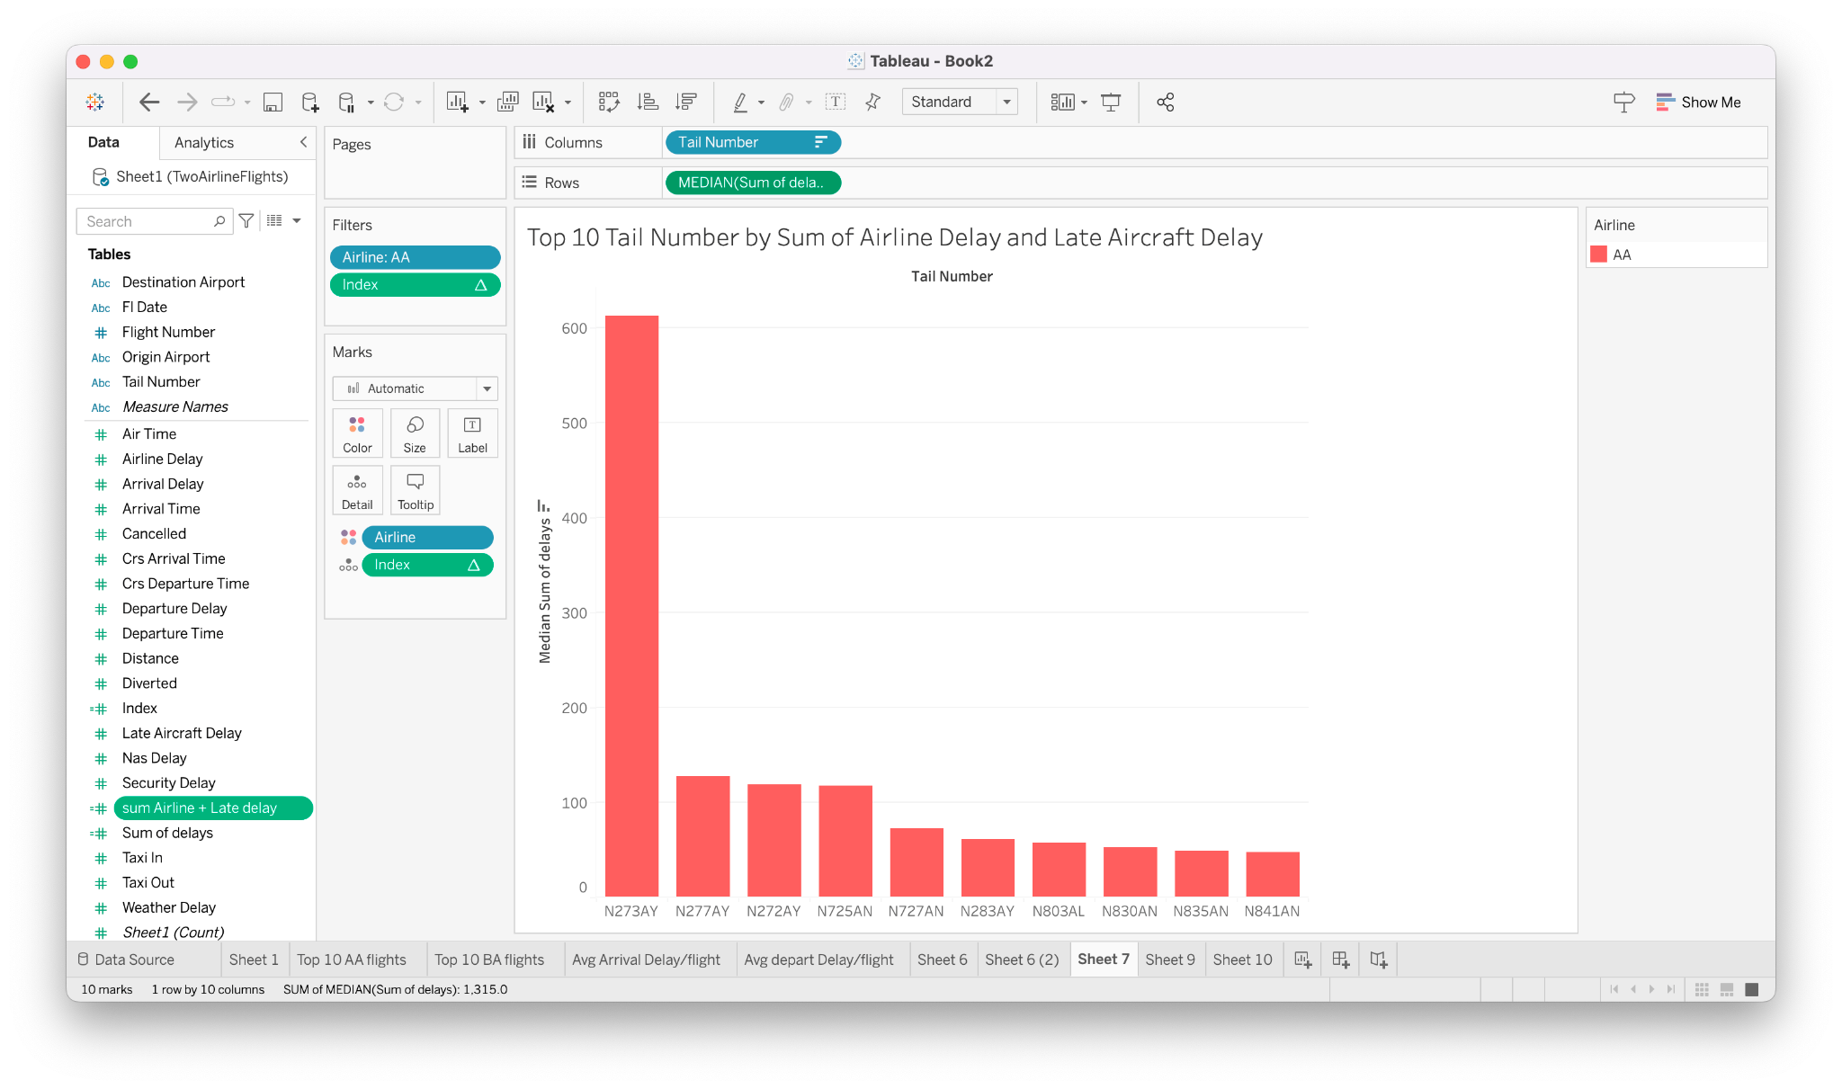
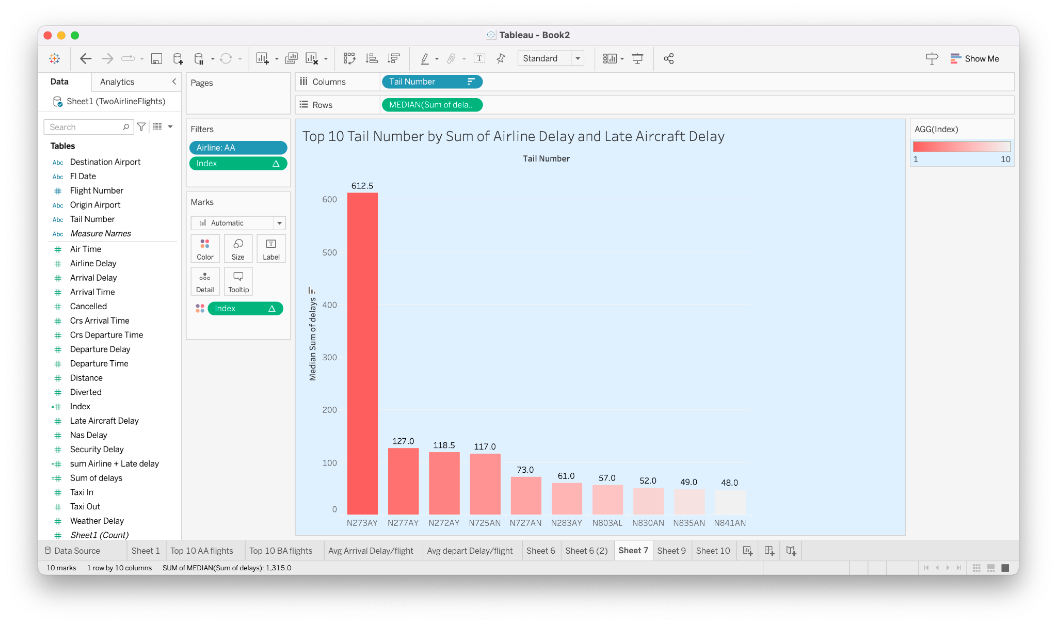
Departure and Arrival Delays
N273AY has as significantly higher median arrival and departure delay than the rest of the flights
AA has a greater proportion of flights with arrival delays that are within their control
Notes:
Means the focus should be on N273AY

Slide 40
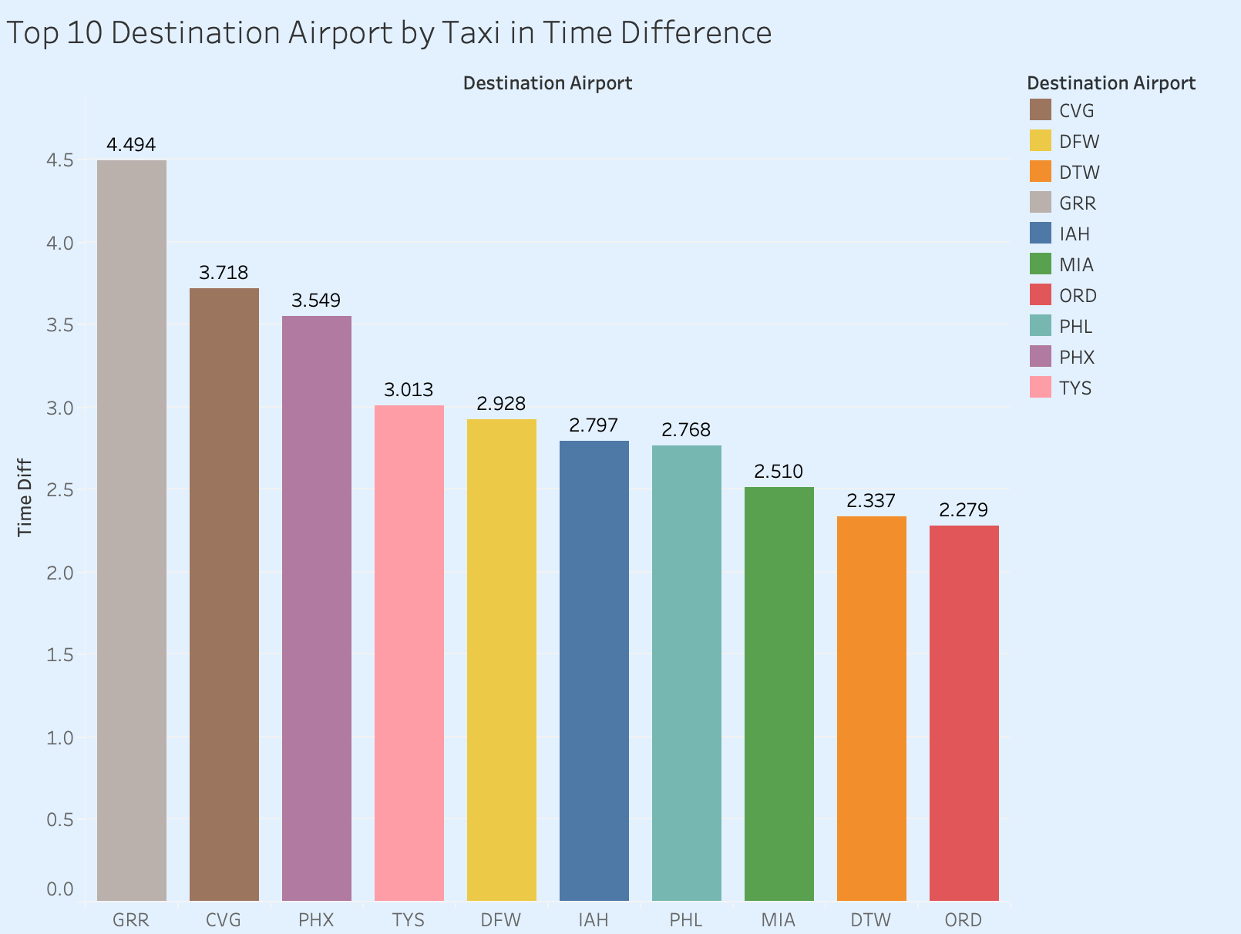
Taxi In Time
Top 10 Airports where we are having significantly higher mean taxi in time than BA
We will look the top 3 aircrafts that contributed to the high taxi in time at each of these airports
Notes:
Keeping

Slide 41
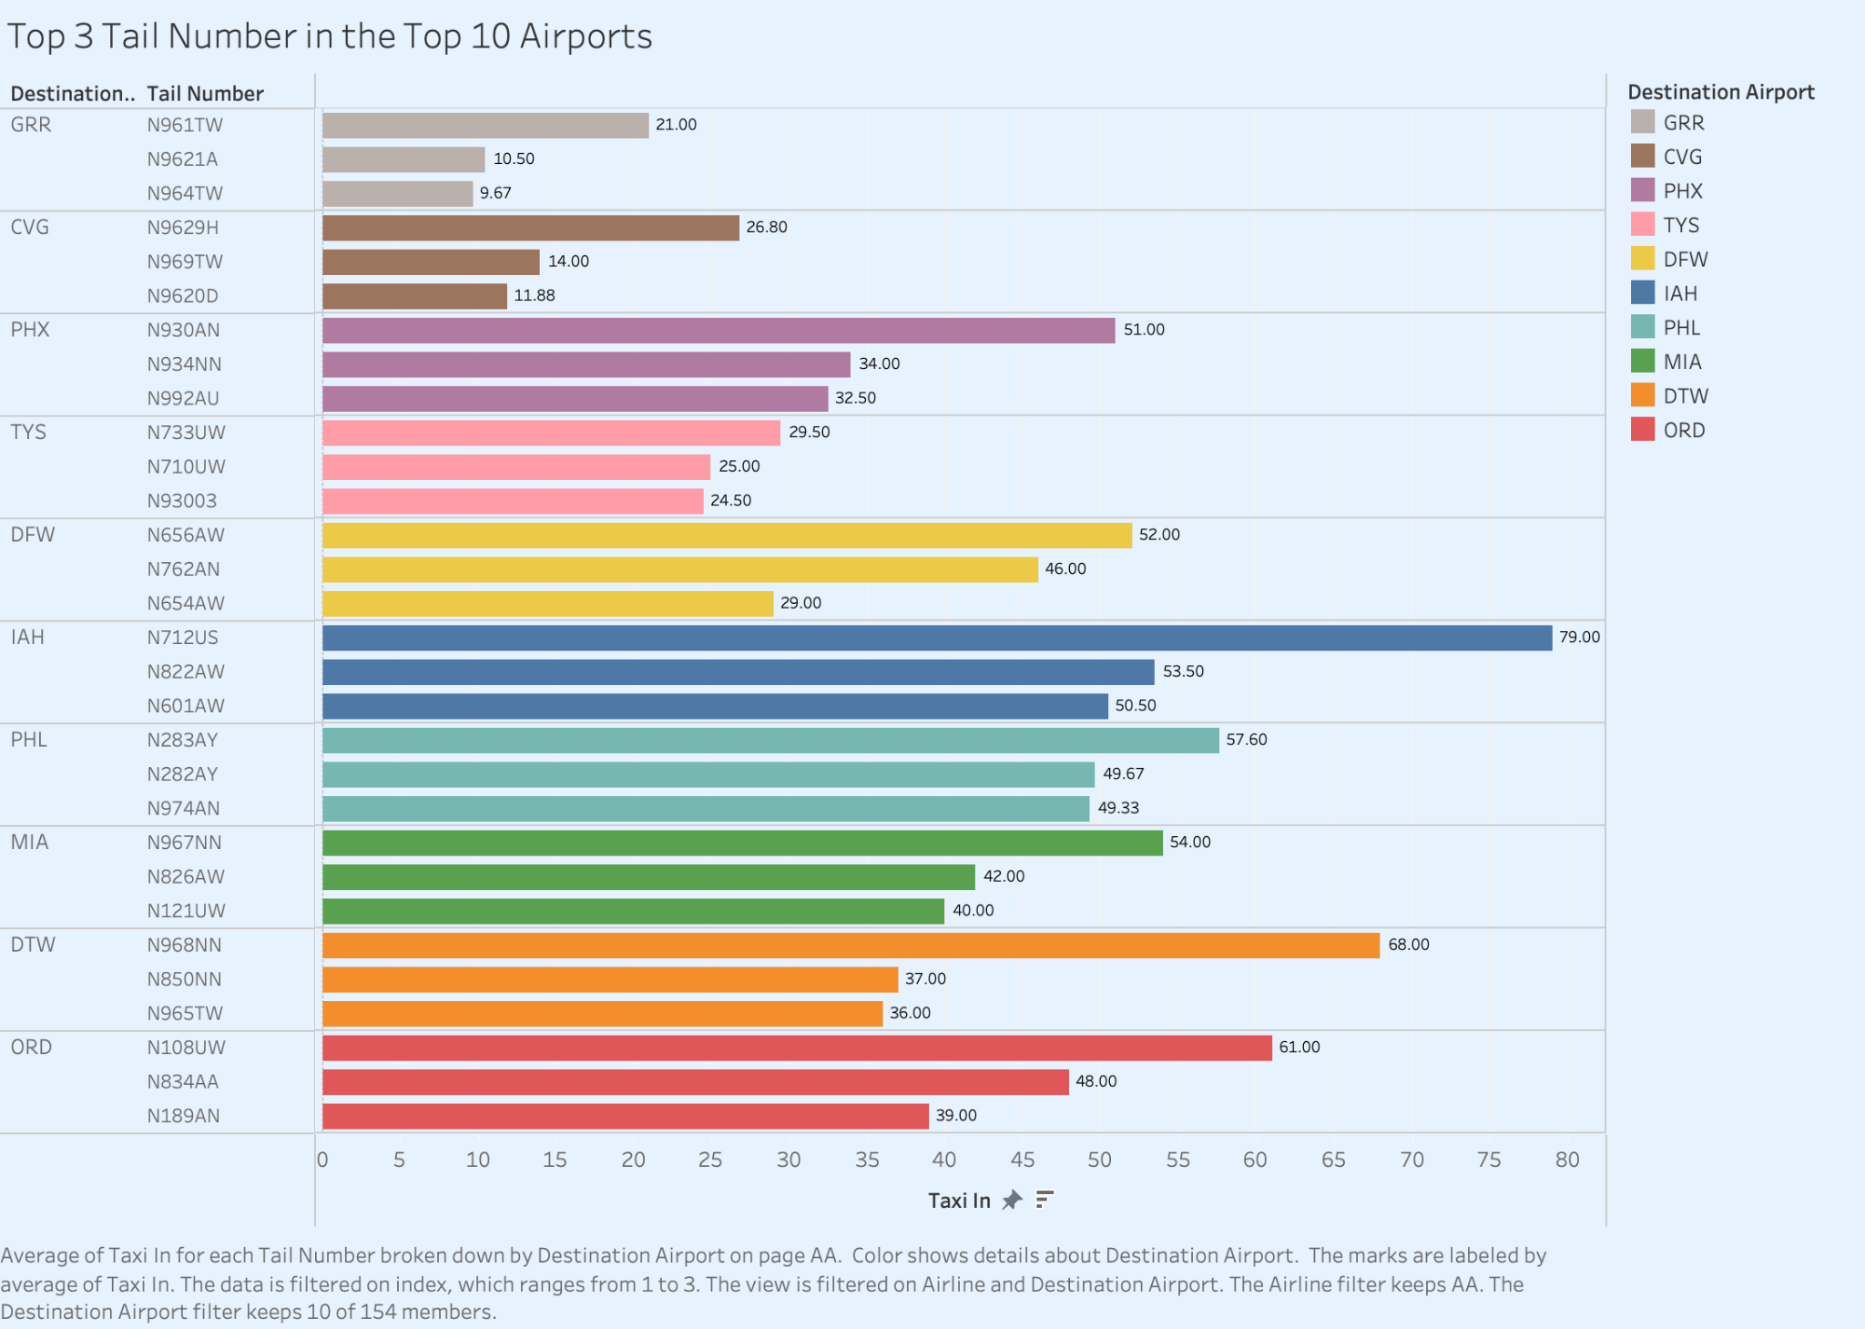
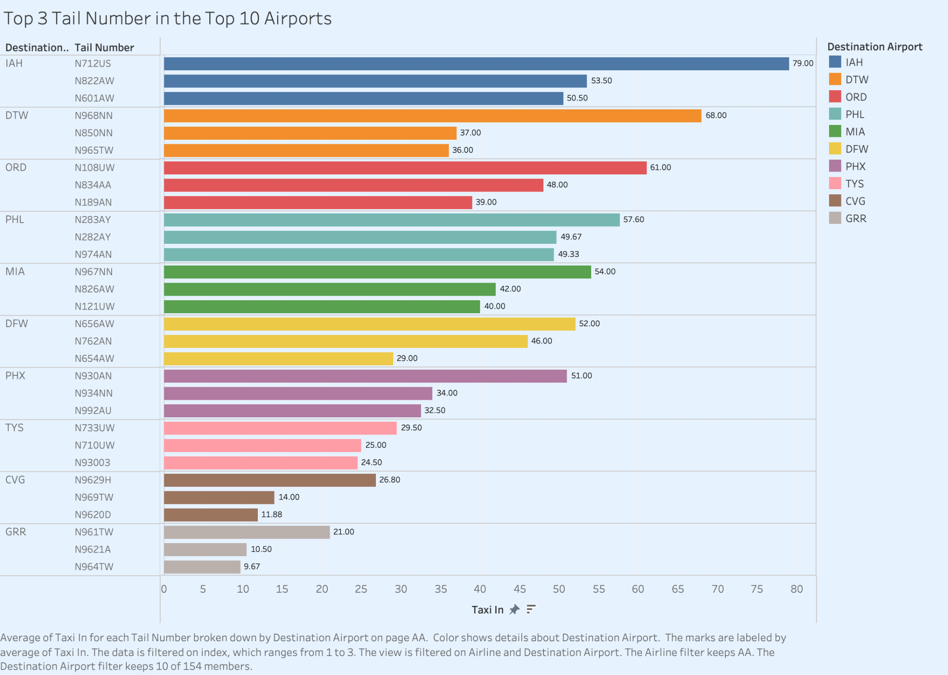
Notes:
These are the flights that led to us performing comparatively worse than berry in terms of taxi in time, at the specified airport

Slide 42
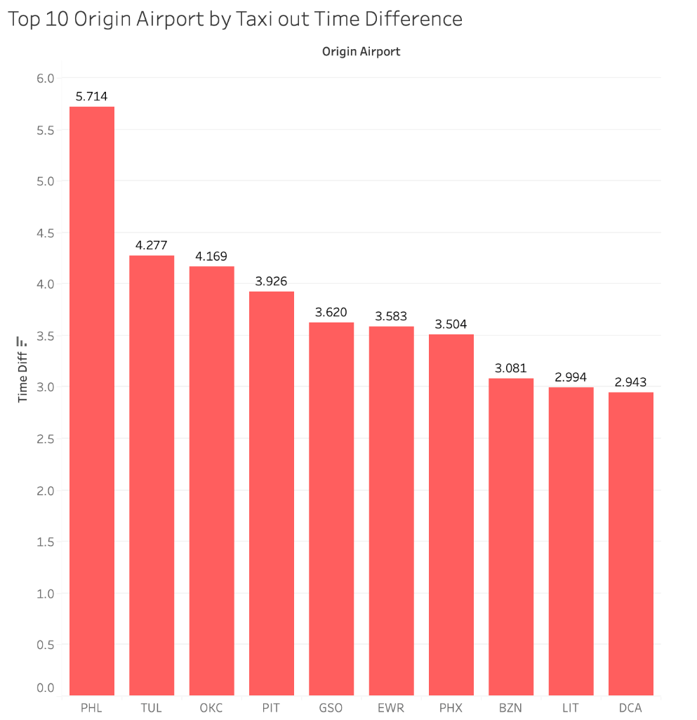
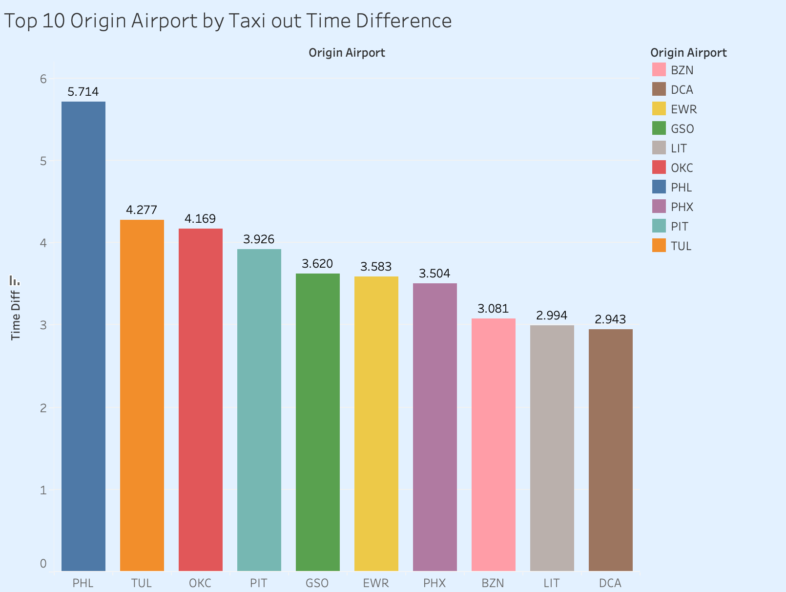
Taxi Out Time
Top 10 Airports where we are having higher mean taxi out time than BA
We will look that the top 3 aircrafts that experience most taxi in time

Slide 43
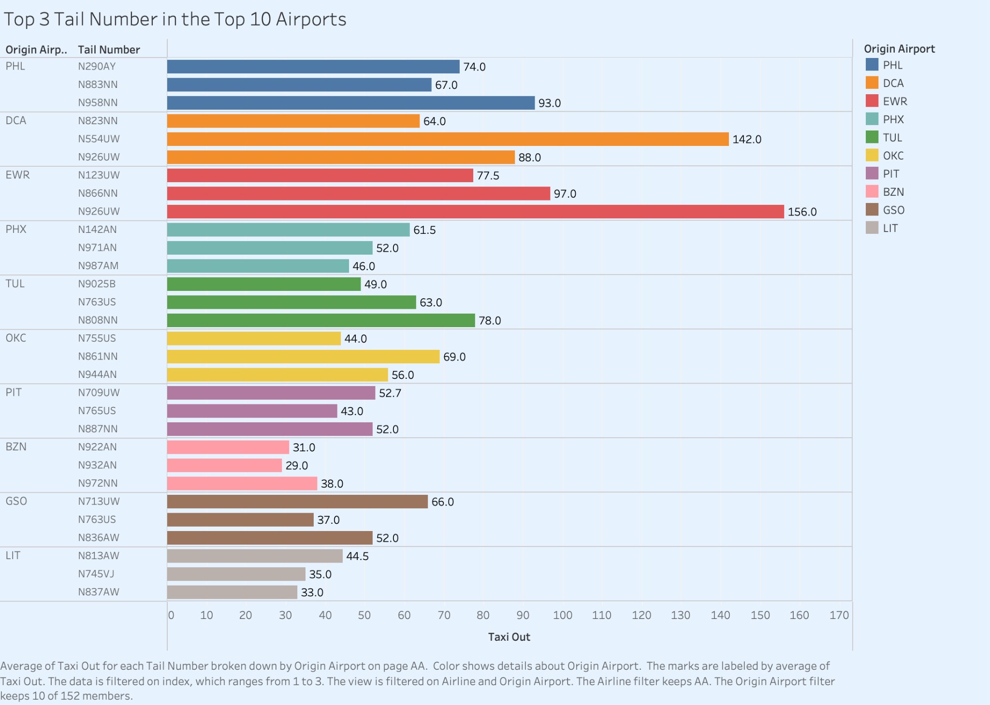
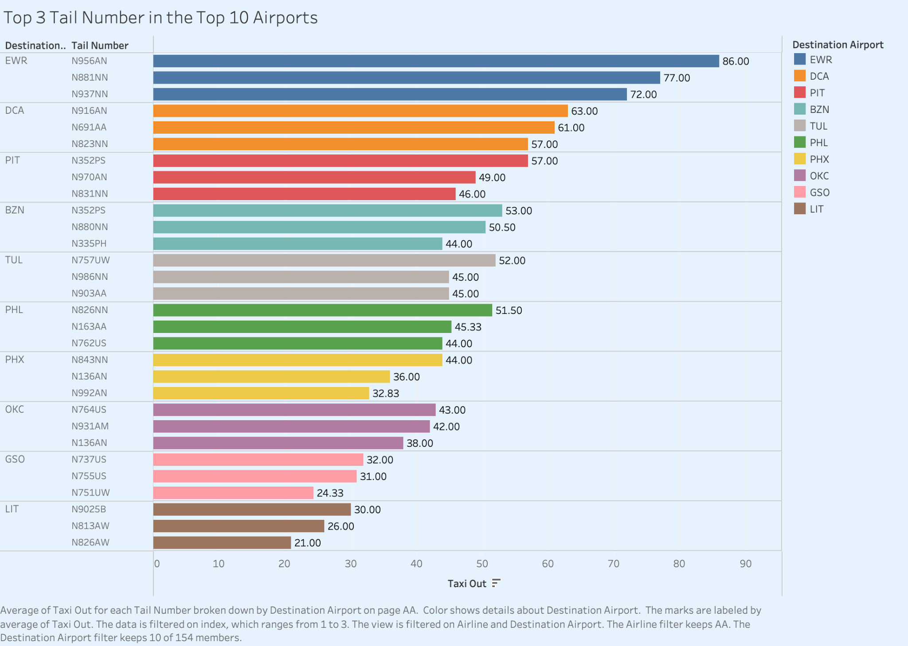

Slide 44
Outline
Areas for
improvement
Are we punctual?
04
Moving
Forward
03
Overview
05
02
01
Are we efficient?
Notes:
Diverted under arrival delays
Outline:
Overview

Slide 45
Moving Forward
5
Notes:
One way to solution
AA has more Airtime than BA
But AA has more delay issues that could be controlled
By solving AA delay issues, can increase airtime -> optimisation

Slide 46
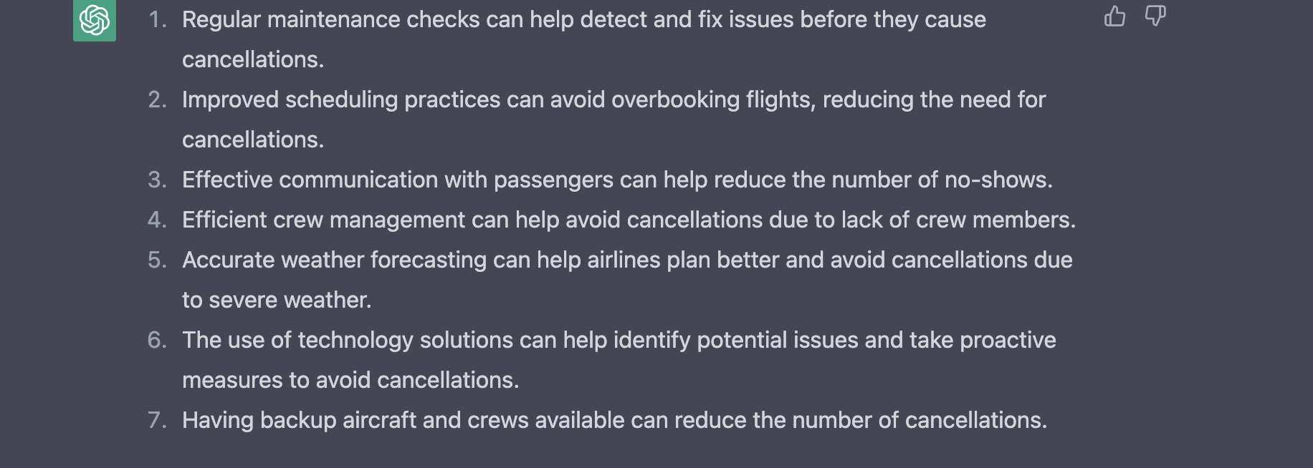
Solutions to reduce cancellations
For cancellations due to reasons within control
Airline/Carriers
Further investigation to identify the root causes
Maintenance
Crew Availability
For cancellations due to reasons beyond control
Weather: Predictive Analytics
Improve scheduling
Develop alternative routes
Notes:
beyond control, but maybe it suggests that we need to look at weather predictive analytics to improve on scheduling and development of alternative plans(e.g. routes)
Airline /Carriers → needs further investigation to identify the root cause(maintenance, crew availability)

Slide 47
Solutions for delays
Identify root cause of delay
Analyse the main reason causing flight N273AY delay
Analyse the cause for airline delay and late aircraft delay
Possible improvements
Optimising scheduling of flights and efficiency of pre-flight processes
Streamline maintenance processes so that flight can depart on time
Plan for contingencies and have backup resources to minimise impact of delays
Look into the pilot and aircraft for N273AY
Notes:
To solve arrival and departure delays, it’s important to first identify the root cause of the delay
Historical data analysis can help identify trend and patterns in delays
Airlines and airports can improve operational efficiency by optimizing schedules, route and maintenance practices
Clear communication and coordination between airlines, airports, and air traffic control can help reduce delays
Planning for contingencies and having backup resources available can help minimize the impact of delays
Technology solutions such as real-time data analytics and predictive modelling can help optimize operations and reduce delays

Slide 48
Future recommendations
Conduct predictive analytics to determine how proposed solutions may impact delay
Conduct prescriptive analytics to determine the most optimised way to move forward

Slide 49
Thank you.

